Slide 1
U3_L3_ALL1
NACA profiles
Class: 5 CM/TL Prof. Massimo Eccher
School year: 2017-18

Slide 2

NACA (National Advisory Committee for Aeronautics)
https://en.wikipedia.org/wiki/National_Advisory_Committee_for_Aeronautics#/media/File:NACA_seal.jpg
NACA, precursor to NASA, was a U.S. agency founded in 1915 to institutionalize aeronautical research.
The NACA airfoils are airfoil shapes described using a series of digits. Before NACA series, airfoil design was rather arbitrary.
The parameters in the code can be entered into equations to precisely generate the cross-section of the airfoil.

Slide 3
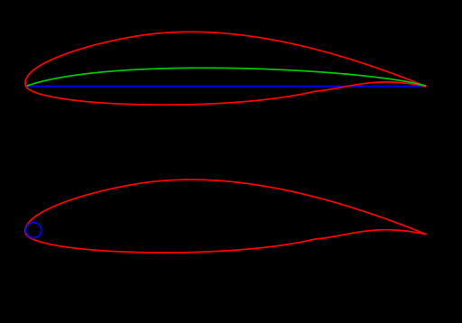
NACA AIRFOIL NAMING CONVENTION
Early NACA series, 4- 5- digit series were generated with analytical equations.
Later families, including 6-digit series, are more complicated shapes.
Example: 4-digit series
First digit specifies maximum camber in percentage of chord
Second digit indicates position of maximum camber in tenths of chord
Last two digits provide maximum thickness of airfoil in percentage of chord
camber mean line
chord
Leading edge radius
By the author

Slide 4
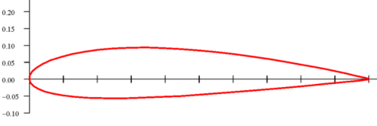
EXAMPLE: NACA FOUR-DIGIT SERIES
First digit specifies maximum camber in percentage of chord
Second digit indicates position of maximum camber in tenths of chord
Last two digits provide maximum thickness of airfoil in percentage of chord
Adapted from
https://commons.wikimedia.org/wiki/File:NACA_2415.svg
Example: NACA 2415
Airfoil has maximum thickness of 15% of chord (0.15c)
Camber of 2% (0.02c) located 40% back from airfoil leading edge (0.4c)

Slide 5
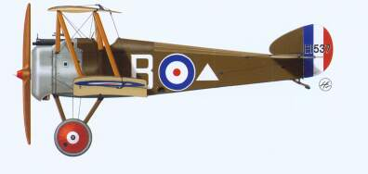
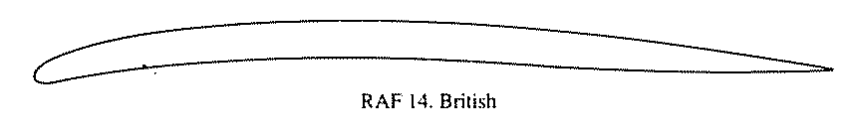
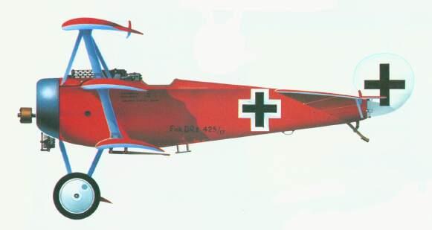
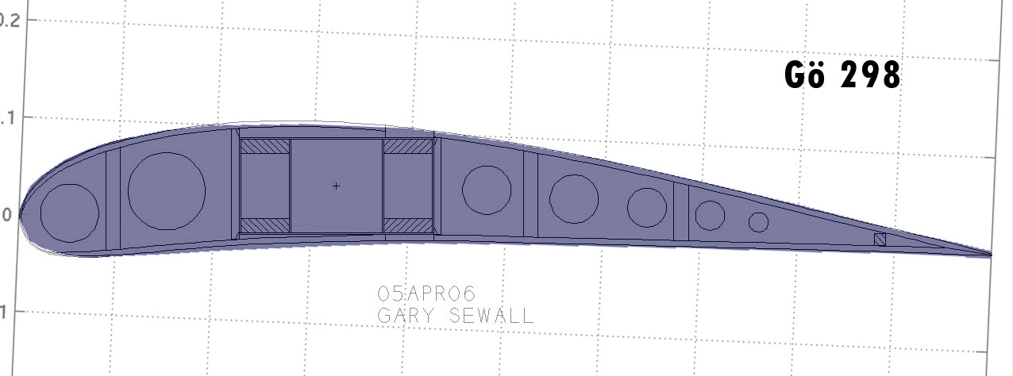
AIRFOIL THICKNESS: World War I AIRPLANES
English Sopwith Camel
https://riseofflight.com/forum/topic/26617-fokker-dvii/
Lower maximum C_{L}
Thin wing, bracing wires required
http://acepilots.com/wwi/sop_camel.html
German Fokker Dr-1
https://riseofflight.com/forum/topic/26617-fokker-dvii/
Higher maximum C_{L}
Higher rates of climb
Improved maneuverability
http://www.fiddlersgreen.net/models/aircraft/Fokker-Dr1.html
What about their NACA codes?

Slide 6
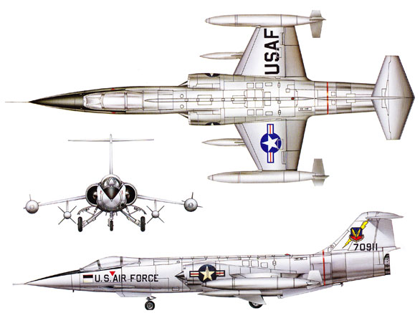
EXAMPLE: F-104 LOCKHEED STARFIGHTER
http://www.fiddlersgreen.net/models/
aircraft/Lockheed-F104.html
1958 – used in Vietnam
First airplane designed for sustained flight at Mach 2
Very sharp leading edge on wings (razor sharp leading edges, thickness 3.4 %)
Designed to minimize wave drag at supersonic speeds
Very poor low-speed aerodynamic performance
Such wings tend to stall at low angles of attack, C_{Lmax} is only about 1.15
V_{stall} (full) ~ 198 MPH, V_{stall} (empty) ~ 152 MPH (V_{stall} proportional to W^{1/2})

Slide 7

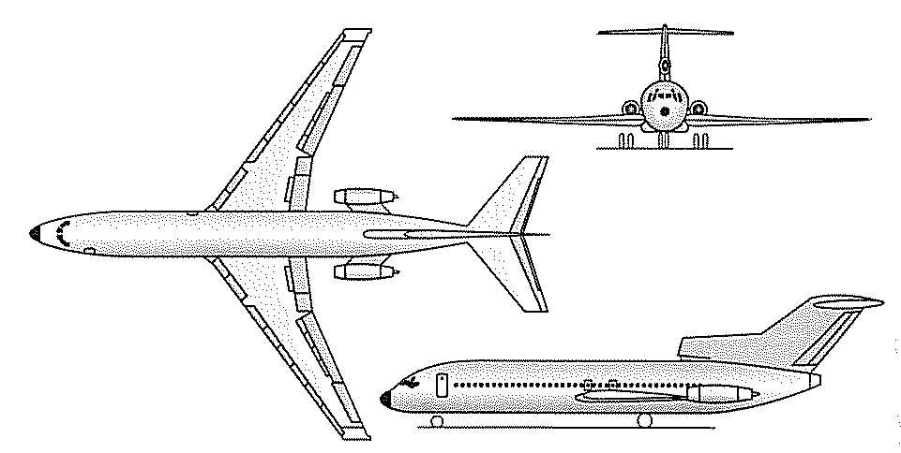
EXAMPLE: BOEING 727
http://www.tailsthroughtime.com/2010/04/ive-always-had-soft-spot-for-boeing-727.html
https://forum.ysfhq.com/viewtopic.php?t=4956
Commercial airplane
Designed in 1960’s to operate out of airports with relatively short runways
Desire to minimize take-off and landing distances
Maximum C_{L} = 3.0
V_{stall} ~ 113 MPH

Slide 8
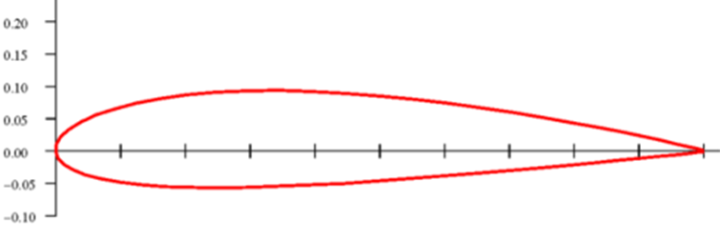
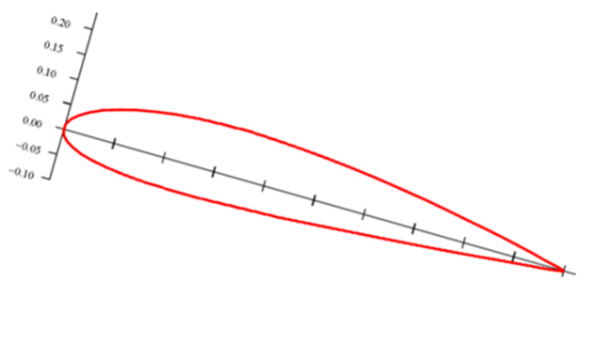
4 cases
Images adapted from:
http://www.apollocanard.com/4_airfoil%20design.htm
NACA 2415 flying right side up
Zero angle of attack
Lift in positive vertical direction
NACA 2415 upside down
Zero angle of attack
Lift in negative vertical direction
α
What if we turn it upside down?
Positive angle of attack
Say α=10º
Lift in positive vertical direction

Slide 9
CAN AN AIRFOIL PRODUCE LIFT WHEN IT IS FLYING UPSIDE DOWN?
α
α
Images adapted from:
http://www.apollocanard.com/4_airfoil%20design.htm
NACA 2415 flying upside down at certain angles of attack will generate positive lift, but less than same airfoil right side up at the same angle of attack
Here is a way to understand this:
  If we take airfoil on left and turn it upside down it is same as airfoil right side up but with a negative angle of attack
  Therefore, lift coefficient for upside down airfoil at a positive angle of attack is given by data for negative angles of attack
  The negative cl connotes a downward lift on the ordinary right side up airfoil when pitched to a negative angle of attack
  In upside down orientation (airfoil on right), lift is directed upwards

